Slide 1
252-0027
Einführung in die Programmierung
Übungen
Woche 10: Verlinkte Objekte, Klassen
Leandro Zazzi
Departement Informatik
ETH Zürich

Slide 2
Organisatorisches
Mein Name: Leandro Zazzi
Bei Fragen: lzazzi@ethz.ch
Mails bitte mit «[EProg25]» im Betreff
Neue Aufgaben: Dienstag Abend (im Normalfall)
Abgabe der Übungen bis Dienstag Abend (23:59) Folgewoche
Abgabe immer via Git
Lösungen in separatem Projekt auf Git

Slide 3
Probleme Lösen
Notes:
Ziel ist es, dass eine Klasse möglichst eigenständig entworfen wird und auf Objektinvarianten (e.g. keine Minutenzahl > 59) aufmerksam gemacht wird

Slide 4
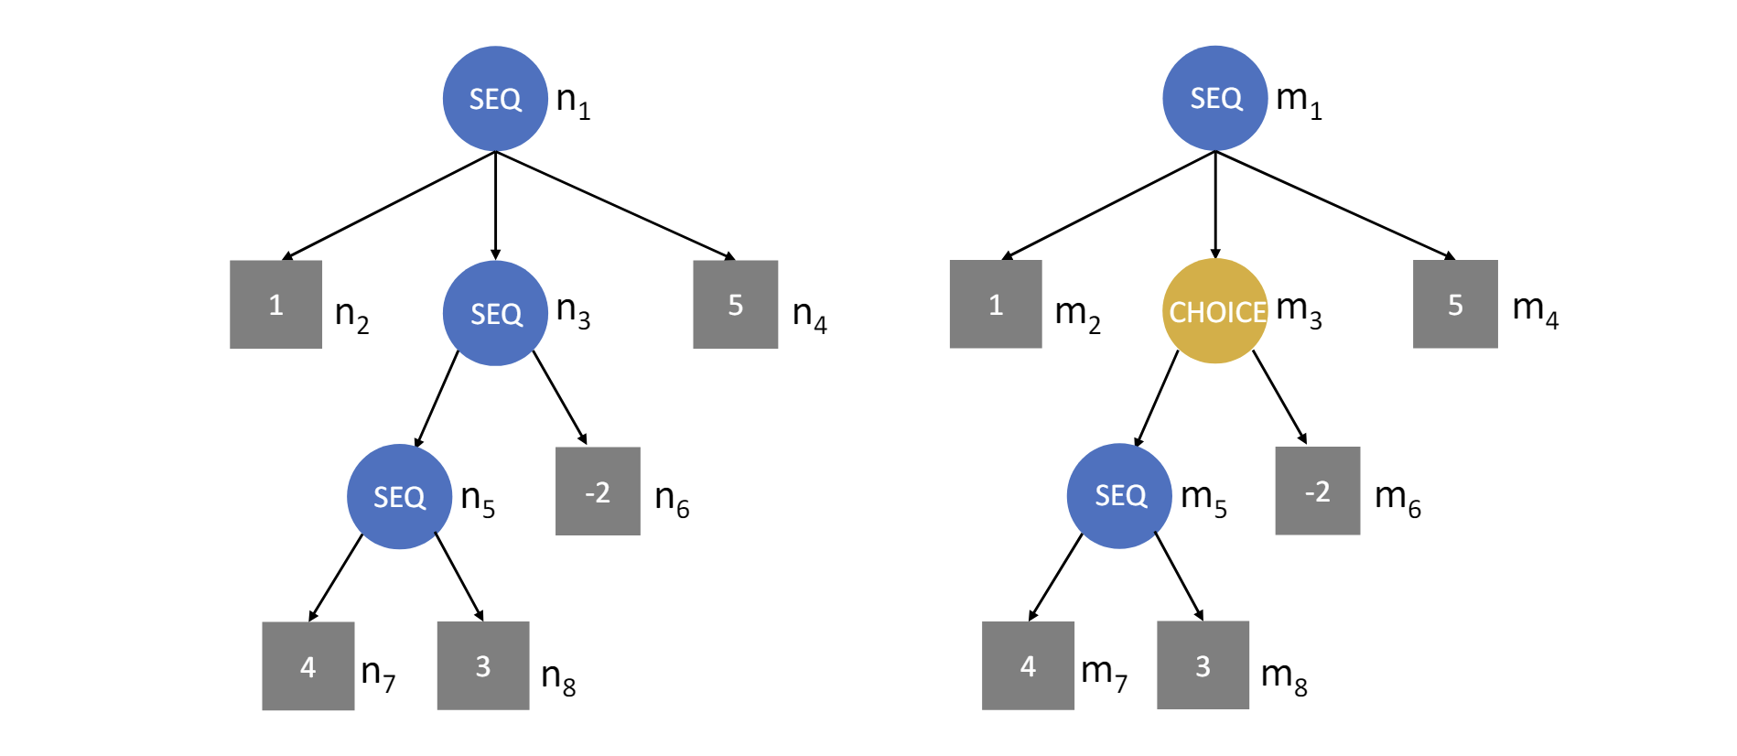
Probleme Lösen: Executable Graph

Slide 5
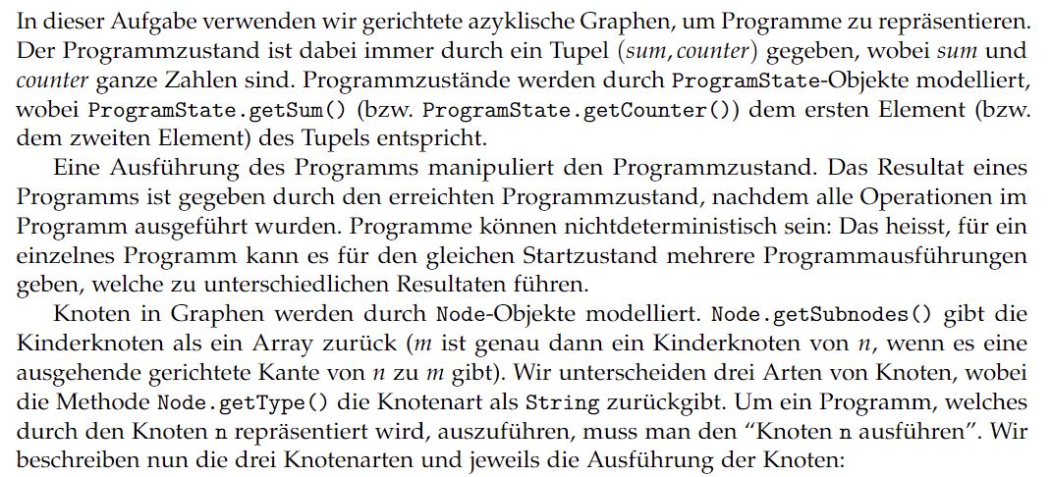





















Probleme Lösen: Executable Graph

Slide 6
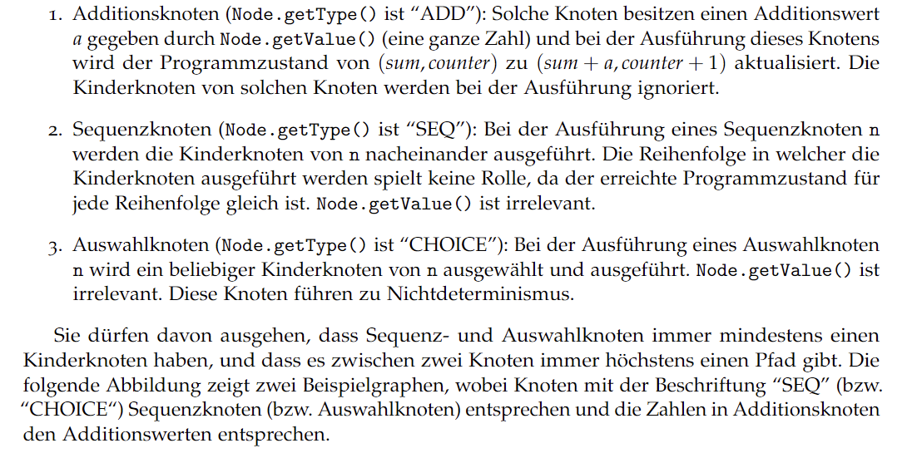



























Probleme Lösen: Executable Graph

Slide 7
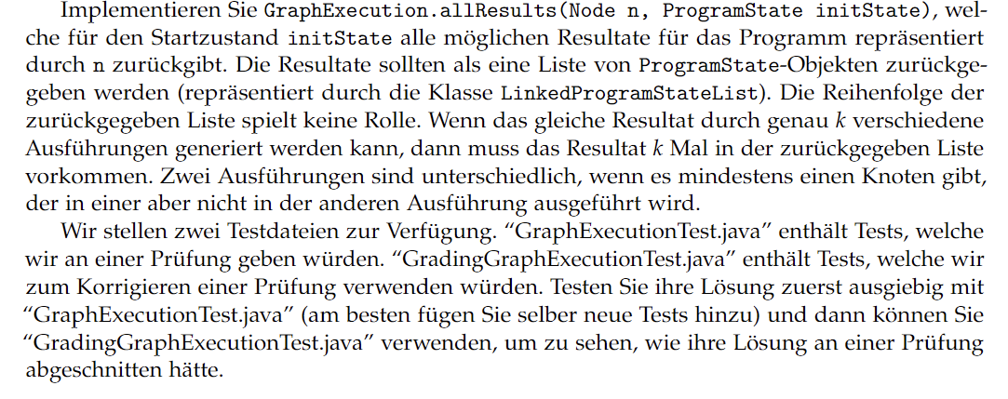


















Probleme Lösen: Executable Graph

Slide 8
Probleme Lösen: Executable Graph
ADD Node: Enthalten value a und wir setzen (sum, counter) auf (sum + a, counter + 1).
Kinderknoten werden bei der Ausführung ignoriert.
SEQ Node: Kinderknoten werden nacheinander ausgeführt. Reihenfolge ist egal. Das value Attribut wird ignoriert.
CHOICE Node: Ein beliebiger Knoten wird ausgeführt. Das value Attribut wird ignoriert.
-2
3
CHOICE
SEQ
CHOICE

Slide 9
Probleme Lösen: Executable Graph

Slide 10
Probleme Lösen: Executable Graph
Startzustand:
(1,2)
SEQ
1
SEQ
5
CHOICE
SEQ
-2
4
3

Slide 11
Probleme Lösen: Executable Graph
Startzustand:
(1,2)
Wir beginnen hier.
SEQ
1
SEQ
5
CHOICE
SEQ
-2
4
3

Slide 12
Probleme Lösen: Executable Graph
(1,2)
SEQ
(1,2)
1
1
SEQ
5
CHOICE
SEQ
-2
4
3

Slide 13
Probleme Lösen: Executable Graph
(1,2)
SEQ
(1+1,2+1)
1
1
SEQ
5
CHOICE
SEQ
-2
4
3

Slide 14
Probleme Lösen: Executable Graph
(1,2)
SEQ
(2,3)
1
1
SEQ
5
CHOICE
SEQ
-2
4
3

Slide 15
Probleme Lösen: Executable Graph
(2,3)
SEQ
1
1
SEQ
5
CHOICE
SEQ
-2
4
3

Slide 16
Probleme Lösen: Executable Graph
(2,3)
SEQ
1
SEQ
5
CHOICE
SEQ
-2
4
3

Slide 17

Probleme Lösen: Executable Graph
(2,3)
SEQ
1
SEQ
5
CHOICE
SEQ
-2
Teilproblem
4
3

Slide 18
Probleme Lösen: Executable Graph
(2,3)
SEQ
(2,3)
1
SEQ
5
SEQ
CHOICE
CHOICE
SEQ
-2
SEQ
-2
4
3
4
3

Slide 19

Probleme Lösen: Executable Graph
(2,3)
SEQ
(2,3)
1
SEQ
5
SEQ
CHOICE
CHOICE
SEQ
-2
SEQ
-2
4
3
4
3
Teilproblem

Slide 20
Probleme Lösen: Executable Graph
(2,3)
SEQ
(2,3)
1
SEQ
5
SEQ
SEQ
CHOICE
CHOICE
CHOICE
(2,3)
SEQ
-2
SEQ
-2
SEQ
4
3
4
3
4
3

Slide 21
Probleme Lösen: Executable Graph
(2,3)
SEQ
(2,3)
1
SEQ
5
SEQ
SEQ
CHOICE
CHOICE
CHOICE
(2,3)
SEQ
-2
SEQ
-2
SEQ
4
3
4
3
4
3

Slide 22
Probleme Lösen: Executable Graph
(2,3)
SEQ
(2,3)
1
SEQ
5
SEQ
SEQ
CHOICE
CHOICE
CHOICE
(6,4)
SEQ
-2
SEQ
-2
SEQ
4
3
4
3
4
3

Slide 23
Probleme Lösen: Executable Graph
(2,3)
SEQ
(2,3)
1
SEQ
5
SEQ
SEQ
CHOICE
CHOICE
CHOICE
(6,4)
SEQ
-2
SEQ
-2
SEQ
4
3
4
3
4
3

Slide 24
Probleme Lösen: Executable Graph
(2,3)
SEQ
(2,3)
1
SEQ
5
SEQ
SEQ
CHOICE
CHOICE
CHOICE
(9,5)
SEQ
-2
SEQ
-2
SEQ
4
3
4
3
4
3

Slide 25
Probleme Lösen: Executable Graph
(2,3)
SEQ
(9,5)
1
SEQ
5
SEQ
SEQ
CHOICE
CHOICE
SEQ
-2
SEQ
-2
4
3
4
3

Slide 26
Probleme Lösen: Executable Graph
(2,3)
SEQ
(9,5)
1
SEQ
5
SEQ
SEQ
CHOICE
CHOICE
SEQ
-2
SEQ
-2
4
3
4
3

Slide 27
Probleme Lösen: Executable Graph
(2,3)
SEQ
(7,6)
1
SEQ
5
SEQ
SEQ
CHOICE
CHOICE
SEQ
-2
SEQ
-2
4
3
4
3

Slide 28
Probleme Lösen: Executable Graph
(7,6)
SEQ
1
SEQ
5
SEQ
CHOICE
SEQ
-2
4
3

Slide 29
Probleme Lösen: Executable Graph
(7,6)
SEQ
1
SEQ
5
SEQ
CHOICE
SEQ
-2
4
3

Slide 30
Probleme Lösen: Executable Graph
(7,6)
SEQ
1
SEQ
5
SEQ
CHOICE
SEQ
-2
4
3

Slide 31
Probleme Lösen: Executable Graph
(12,7)
SEQ
1
SEQ
5
SEQ
CHOICE
SEQ
-2
4
3

Slide 32
Probleme Lösen: Executable Graph

Slide 33
Probleme Lösen: Executable Graph
Startzustand:
(0,0)
SEQ
1
CHOICE
5
CHOICE
SEQ
-2
4
3

Slide 34
Probleme Lösen: Executable Graph
Startzustand:
(0,0)
SEQ
1
CHOICE
5
CHOICE
SEQ
-2
4
3

Slide 35
Probleme Lösen: Executable Graph
Startzustand:
(1,1)
SEQ
1
CHOICE
5
CHOICE
SEQ
-2
4
3

Slide 36
Probleme Lösen: Executable Graph
Startzustand:
(1,1)
SEQ
1
CHOICE
5
CHOICE
SEQ
-2
4
3

Slide 37
Probleme Lösen: Executable Graph
Startzustand:
(1,1)
SEQ
Wir haben jetzt die Wahl zwischen zwei Kinderknoten.
1
CHOICE
5
CHOICE
SEQ
-2
4
3

Slide 38
Probleme Lösen: Executable Graph
Resultat 1
Resultat 2
(1,1)
(1,1)
SEQ
SEQ
1
CHOICE
5
1
CHOICE
5
CHOICE
CHOICE
SEQ
SQ
-2
4
3

Slide 39
Probleme Lösen: Executable Graph
Resultat 1
Resultat 2
(1,1)
(1,1)
SEQ
SEQ
1
CHOICE
5
1
CHOICE
5
CHOICE
CHOICE
SEQ
-2
4
3

Slide 40
Probleme Lösen: Executable Graph
Resultat 1
Resultat 2
(5,2)
(1,1)
SEQ
SEQ
1
CHOICE
5
1
CHOICE
5
CHOICE
CHOICE
SEQ
-2
4
3

Slide 41
Probleme Lösen: Executable Graph
Resultat 1
Resultat 2
(5,2)
(1,1)
SEQ
SEQ
1
CHOICE
5
1
CHOICE
5
CHOICE
CHOICE
SEQ
-2
4
3

Slide 42
Probleme Lösen: Executable Graph
Resultat 1
Resultat 2
(8,3)
(1,1)
SEQ
SEQ
1
CHOICE
5
1
CHOICE
5
CHOICE
CHOICE
SEQ
-2
4
3

Slide 43
Probleme Lösen: Executable Graph
Resultat 1
Resultat 2
(8,3)
(1,1)
SEQ
SEQ
1
CHOICE
5
1
CHOICE
5
CHOICE
CHOICE
SEQ
-2
4
3

Slide 44
Probleme Lösen: Executable Graph
Resultat 1
Resultat 2
(8,3)
(-1,2)
SEQ
SEQ
1
CHOICE
5
1
CHOICE
5
CHOICE
CHOICE
SEQ
-2
4
3

Slide 45
Probleme Lösen: Executable Graph
Resultat 1
Resultat 2
(8,3)
(-1,2)
SEQ
SEQ
1
CHOICE
5
1
CHOICE
5
CHOICE
CHOICE
SEQ
-2
4
3

Slide 46
Probleme Lösen: Executable Graph
Resultat 1
Resultat 2
(8,3)
(-1,2)
Wir speichern alle möglichen Lösungen in einer Liste.
SEQ
SEQ
1
CHOICE
5
1
CHOICE
5
CHOICE
CHOICE
{(8,3),(-1,2)}
SEQ
-2
4
3

Slide 47
Probleme Lösen: Executable Graph
Lösungen:
{(8,3),(-1,2)}
SEQ
1
CHOICE
5
CHOICE
SEQ
-2
4
3

Slide 48
Probleme Lösen: Executable Graph
Lösungen:
Wir müssen jedes Zwischenresultat in der Liste updaten.
{(8,3),(-1,2)}
SEQ
1
CHOICE
5
CHOICE
SEQ
-2
4
3

Slide 49
Probleme Lösen: Executable Graph
Lösungen:
{(8+5,3+1),(-1+5,2+1)}
SEQ
1
CHOICE
5
CHOICE
SEQ
-2
4
3

Slide 50
Probleme Lösen: Executable Graph
Lösungen:
{(13,4),(4,3)}
SEQ
1
CHOICE
5
CHOICE
SEQ
-2
4
3

Slide 51
Wie lösen wir das Problem?
Wir nutzen eine Helfermethode allResultsGo welche statt nur einem Programmstate eine Liste von Programmstates als Parameter hat.
ADD: Für alle Zwischenresultate addiere value dazu, erhöhe den Counter um 1 und füge das Resultat zu next hinzu.
SEQ: Rufe für alle Kinderknoten die Methode allResultsGo auf. Wir speichern die zurückgegebene Liste und nutzen diese als Parameter für den nächsten Kinderknoten.
CHOICE: Rufe für alle Kinderknoten die Methode allResultsGo auf. Wir berechnen die Resultate für jeden Kinderknoten separat und fügen die Listen zusammen.

Slide 52
public static LinkedProgramStateList allResultsGo(Node n, LinkedProgramStateList states) {
if (n.getType().equals("ADD")) {
LinkedProgramStateList next = new LinkedProgramStateList();
for (int i = 0; i < states.size; i += 1) {
ProgramState state = states.get(i);
next.addLast(new ProgramState(state.getSum() + n.getValue(), state.getCounter() + 1));
}
return next;
}
(…)
}
Neue Liste wird erstellt, da wir nicht states ändern wollen.

Slide 53
public static LinkedProgramStateList allResultsGo(Node n, LinkedProgramStateList states) {
if (n.getType().equals("ADD")) {
LinkedProgramStateList next = new LinkedProgramStateList();
for (int i = 0; i < states.size; i += 1) {
ProgramState state = states.get(i);
next.addLast(new ProgramState(state.getSum() + n.getValue(), state.getCounter() + 1));
}
return next;
}
(…)
}
Für jedes Zwischenresult in der Liste states wird value zur Summe hinzugefügt und der Counter erhöht.

Slide 54
public static LinkedProgramStateList allResultsGo(Node n, LinkedProgramStateList states) {
if (n.getType().equals("ADD")) {
LinkedProgramStateList next = new LinkedProgramStateList();
for (int i = 0; i < states.size; i += 1) {
ProgramState state = states.get(i);
next.addLast(new ProgramState(state.getSum() + n.getValue(), state.getCounter() + 1));
}
return next;
}
(…)
}
Für jedes Zwischenresult in der Liste states wird value zur Summe hinzugefügt und der Counter erhöht.

Slide 55
public static LinkedProgramStateList allResultsGo(Node n, LinkedProgramStateList states) {
(…)
} else if (n.getType().equals("SEQ")) {
LinkedProgramStateList next = states;
for (Node ch : n.getSubnodes()) { //Recursively update the results
next = allResultsGo(ch, next);
}
return next;
}
(…)
}
Wir verändern die Liste auf welche states verweist nicht, weil wir bei ADD notes eine neue Liste erstellen. Hier wird aber keine Kopie erstellt!

Slide 56
public static LinkedProgramStateList allResultsGo(Node n, LinkedProgramStateList states) {
(…)
} else if (n.getType().equals("SEQ")) {
LinkedProgramStateList next = states;
for (Node ch : n.getSubnodes()) {
next = allResultsGo(ch, next);
}
return next;
}
(…)
}
Wir rufen für jeden Kinderknoten die Methode rekursiv auf.

Slide 57
public static LinkedProgramStateList allResultsGo(Node n, LinkedProgramStateList states) {
(…)
} else if (n.getType().equals("CHOICE")) {
LinkedProgramStateList next = new LinkedProgramStateList();
for (Node ch : n.getSubnodes()) {
LinkedProgramStateList results = allResultsGo(ch, states);
for (int i = 0; i < results.size; i += 1) {
next.addLast(results.get(i));
}
}
return next;
}
return null;
}
Für jeden Kinderknoten wird eine Liste zurückgegeben und wir fügen diese dann zusammen.

Slide 58
VARIANTE 2

Slide 59
Listen

Slide 60
LinkedLists

Slide 61
LinkedLists
class Node {
int value;
Node next;
Node(int value) {
this.value = value;
this.next = null;
}
}
single linked list Knotenaufbau
Notes:
This. Hier notwendig?

Slide 62
LinkedLists
Referenz auf Objekt des selben Typs!
class Node {
int value;
Node next;
Node(int value) {
this.value = value;
this.next = null;
}
}
single linked list Knotenaufbau
Notes:
This. Hier notwendig?

Slide 63
LinkedLists
Referenz auf Objekt des selben Typs!
class Node {
int value;
Node next;
Node(int value) {
this.value = value;
this.next = null;
}
}
single linked list Knotenaufbau
Node
value
next
Node
value
next
Node
value
next
null
var
Notes:
This. Hier notwendig?

Slide 64
LinkedLists
class Node {
int value;
Node next;
Node(int value) {
this.value = value;
this.next = null;
}
}
single linked list Knotenaufbau
Node head = new Node(42);
head.next = new Node(-3);
head.next.next = new Node(17);
Beispiel
Notes:
This. Hier notwendig?

Slide 65
LinkedLists
class Node {
int value;
Node next;
Node(int value) {
this.value = value;
this.next = null;
}
}
single linked list Knotenaufbau
Node head = new Node(42);
head.next = new Node(-3);
head.next.next = new Node(17);
Beispiel
Node
value =
next =
head
Notes:
This. Hier notwendig?

Slide 66
LinkedLists
class Node {
int value;
Node next;
Node(int value) {
this.value = value;
this.next = null;
}
}
single linked list Knotenaufbau
Node head = new Node(42);
head.next = new Node(-3);
head.next.next = new Node(17);
Beispiel
Node
value = 42
next =
head
Notes:
This. Hier notwendig?

Slide 67
LinkedLists
class Node {
int value;
Node next;
Node(int value) {
this.value = value;
this.next = null;
}
}
single linked list Knotenaufbau
Node head = new Node(42);
head.next = new Node(-3);
head.next.next = new Node(17);
Beispiel
Node
value = 42
next =
null
head
Notes:
This. Hier notwendig?

Slide 68
LinkedLists
class Node {
int value;
Node next;
Node(int value) {
this.value = value;
this.next = null;
}
}
single linked list Knotenaufbau
Node head = new Node(42);
head.next = new Node(-3);
head.next.next = new Node(17);
Beispiel
Node
value = 42
next =
Node
value = -3
next =
null
head
Notes:
This. Hier notwendig?

Slide 69
LinkedLists
class Node {
int value;
Node next;
Node(int value) {
this.value = value;
this.next = null;
}
}
single linked list Knotenaufbau
Node head = new Node(42);
head.next = new Node(-3);
head.next.next = new Node(17);
Beispiel
Node
value = 42
next =
null
head
Notes:
This. Hier notwendig?

Slide 70
LinkedLists
class Node {
int value;
Node next;
Node(int value) {
this.value = value;
this.next = null;
}
}
single linked list Knotenaufbau
Node head = new Node(42);
head.next = new Node(-3);
head.next.next = new Node(17);
Beispiel
Node
value = 42
next =
null
head
Notes:
This. Hier notwendig?

Slide 71
LinkedLists
class Node {
int value;
Node next;
Node(int value) {
this.value = value;
this.next = null;
}
}
single linked list Knotenaufbau
Node head = new Node(42);
head.next = new Node(-3);
head.next.next = new Node(17);
Beispiel
Node
value = 42
next =
null
head
Notes:
This. Hier notwendig?

Slide 72
LinkedLists
class Node {
int value;
Node next;
Node(int value) {
this.value = value;
this.next = null;
}
}
single linked list Knotenaufbau
Node head = new Node(42);
head.next = new Node(-3);
head.next.next = new Node(17);
Beispiel
Node
value = 42
next =
Node
value =
next =
head
Notes:
This. Hier notwendig?

Slide 73
LinkedLists
class Node {
int value;
Node next;
Node(int value) {
this.value = value;
this.next = null;
}
}
single linked list Knotenaufbau
Node head = new Node(42);
head.next = new Node(-3);
head.next.next = new Node(17);
Beispiel
Node
value = 42
next =
Node
value = -3
next =
head
Notes:
This. Hier notwendig?

Slide 74
LinkedLists
class Node {
int value;
Node next;
Node(int value) {
this.value = value;
this.next = null;
}
}
single linked list Knotenaufbau
Node head = new Node(42);
head.next = new Node(-3);
head.next.next = new Node(17);
Beispiel
Node
value = 42
next =
Node
value = -3
next =
null
head
Notes:
This. Hier notwendig?

Slide 75
LinkedLists
class Node {
int value;
Node next;
Node(int value) {
this.value = value;
this.next = null;
}
}
single linked list Knotenaufbau
Node head = new Node(42);
head.next = new Node(-3);
head.next.next = new Node(17);
Beispiel
Node
value = 42
next =
Node
value = -3
next =
Node
value = 17
next =
null
head
Notes:
This. Hier notwendig?

Slide 76
LinkedLists
class Node {
int value;
Node next;
Node(int value) {
this.value = value;
this.next = null;
}
}
single linked list Knotenaufbau
Node head = new Node(42);
head.next = new Node(-3);
head.next.next = new Node(17);
Beispiel
Node
value = 42
next =
Node
value = -3
next =
Node
value = 17
next =
null
head
Notes:
This. Hier notwendig?

Slide 77
LinkedLists
class Node {
int value;
Node next;
Node(int value) {
this.value = value;
this.next = null;
}
}
single linked list Knotenaufbau
head.next.next = new Node(15); was passiert nun?
Node
value = 42
next =
Node
value = -3
next =
Node
value = 17
next =
null
head
Notes:
This. Hier notwendig?

Slide 78
LinkedLists
class Node {
int value;
Node next;
Node(int value) {
this.value = value;
this.next = null;
}
}
single linked list Knotenaufbau
head.next.next = new Node(15); was passiert nun?
Node
value = 42
next =
Node
value = -3
next =
Node
value = 17
next =
null
head
Node
value = 15
next =
Notes:
This. Hier notwendig?

Slide 79
LinkedLists
class Node {
int value;
Node next;
Node(int value) {
this.value = value;
this.next = null;
}
}
single linked list Knotenaufbau
head.next.next = new Node(15); was passiert nun?
head.next = head.next.next;
was passiert nun?
Node
value = 42
next =
Node
value = -3
next =
Node
value = 17
next =
null
head
Node
value = 15
next =
Notes:
This. Hier notwendig?

Slide 80
LinkedLists
class Node {
int value;
Node next;
Node(int value) {
this.value = value;
this.next = null;
}
}
single linked list Knotenaufbau
head.next.next = new Node(15); was passiert nun?
head.next = head.next.next;
was passiert nun?
Node
value = 42
next =
Node
value = -3
next =
Node
value = 17
next =
null
head
Node
value = 15
next =
Notes:
This. Hier notwendig?

Slide 81
LinkedLists
class Node {
int value;
Node next;
Node(int value) {
this.value = value;
this.next = null;
}
}
single linked list Knotenaufbau
head.next.next = new Node(15); was passiert nun?
head.next = head.next.next;
was passiert nun?
Node
value = 42
next =
Node
value = -3
next =
Node
value = 17
next =
null
head
Node
value = 15
next =
Notes:
This. Hier notwendig?

Slide 82
LinkedLists
class Node {
int value;
Node next;
Node(int value) {
this.value = value;
this.next = null;
}
}
single linked list Knotenaufbau
head.next.next = new Node(15); was passiert nun?
head.next = head.next.next;
was passiert nun?
Node
value = 42
next =
Node
value = -3
next =
Node
value = 17
next =
null
head
Schreibzugriff
Node
value = 15
next =
Notes:
This. Hier notwendig?

Slide 83
LinkedLists
class Node {
int value;
Node next;
Node(int value) {
this.value = value;
this.next = null;
}
}
single linked list Knotenaufbau
head.next.next = new Node(15); was passiert nun?
head.next = head.next.next;
was passiert nun?
Node
value = 42
next =
Node
value = -3
next =
Node
value = 17
next =
null
head
Node
value = 15
next =
Notes:
This. Hier notwendig?

Slide 84
LinkedLists
class Node {
int value;
Node next;
Node(int value) {
this.value = value;
this.next = null;
}
}
single linked list Knotenaufbau
head.next.next = new Node(15); was passiert nun?
head.next = head.next.next;
was passiert nun?
Node
value = 42
next =
Node
value = -3
next =
Node
value = 17
next =
null
head
Node
value = 15
next =
Notes:
This. Hier notwendig?

Slide 85
LinkedLists
class Node {
int value;
Node next;
Node(int value) {
this.value = value;
this.next = null;
}
}
single linked list Knotenaufbau
head.next.next = new Node(15); was passiert nun?
head.next = head.next.next;
was passiert nun?
Node
value = 42
next =
Node
value = -3
next =
Node
value = 17
next =
null
head
Node
value = 15
next =
Notes:
This. Hier notwendig?

Slide 86
LinkedLists
class Node {
int value;
Node next;
Node(int value) {
this.value = value;
this.next = null;
}
}
single linked list Knotenaufbau
head.next.next = new Node(15); was passiert nun?
head.next = head.next.next;
was passiert nun?
Node
value = 42
next =
Node
value = -3
next =
Node
value = 17
next =
null
head
Node
value = 15
next =
Notes:
This. Hier notwendig?

Slide 87
LinkedLists
class Node {
int value;
Node next;
Node(int value) {
this.value = value;
this.next = null;
}
}
single linked list Knotenaufbau
head.next.next = new Node(15); was passiert nun?
head.next = head.next.next;
was passiert nun?
Node
value = 42
next =
Node
value = -3
next =
Node
value = 17
next =
null
head
Lesezugriff
Node
value = 15
next =
Notes:
This. Hier notwendig?

Slide 88
LinkedLists
class Node {
int value;
Node next;
Node(int value) {
this.value = value;
this.next = null;
}
}
single linked list Knotenaufbau
head.next.next = new Node(15); was passiert nun?
head.next = head.next.next;
was passiert nun?
Node
value = 42
next =
Node
value = -3
next =
Node
value = 17
next =
null
head
Node
value = 15
next =
Notes:
This. Hier notwendig?

Slide 89
LinkedLists
class Node {
int value;
Node next;
Node(int value) {
this.value = value;
this.next = null;
}
}
single linked list Knotenaufbau
head.next.next = new Node(15); was passiert nun?
head.next = head.next.next;
was passiert nun?
Node
value = 42
next =
Node
value = -3
next =
Node
value = 17
next =
null
head
Node
value = 15
next =
Notes:
This. Hier notwendig?

Slide 90
LinkedLists durchlaufen
class Node {
int value;
Node next;
Node(int value) {
this.value = value;
this.next = null;
}
}
Node head = new Node(42);
head.next = new Node(-3);
head.next.next = new Node(17);
Node current = head;
while (current != null) {
System.out.println(current.value);
current = current.next;
}
Node
value = 42
next =
Node
value = -3
next =
Node
value = 17
next =
null
head
Output: 42 -3 17

Slide 91
LinkedLists durchlaufen
class Node {
int value;
Node next;
Node(int value) {
this.value = value;
this.next = null;
}
}
Node head = new Node(42);
head.next = new Node(-3);
head.next.next = new Node(17);
Node current = head;
while (current != null) {
System.out.println(current.value);
current = current.next;
}
current
Node
value = 42
next =
Node
value = -3
next =
Node
value = 17
next =
null
head
Output: 42 -3 17

Slide 92
LinkedLists durchlaufen
class Node {
int value;
Node next;
Node(int value) {
this.value = value;
this.next = null;
}
}
Node head = new Node(42);
head.next = new Node(-3);
head.next.next = new Node(17);
Node current = head;
while (current != null) {
System.out.println(current.value);
current = current.next;
}
current
Node
value = 42
next =
Node
value = -3
next =
Node
value = 17
next =
null
head
Output: 42 -3 17

Slide 93
LinkedLists durchlaufen
class Node {
int value;
Node next;
Node(int value) {
this.value = value;
this.next = null;
}
}
Node head = new Node(42);
head.next = new Node(-3);
head.next.next = new Node(17);
Node current = head;
while (current != null) {
System.out.println(current.value);
current = current.next;
}
current
Node
value = 42
next =
Node
value = -3
next =
Node
value = 17
next =
null
head
Output: 42 -3 17

Slide 94
LinkedLists durchlaufen
class Node {
int value;
Node next;
Node(int value) {
this.value = value;
this.next = null;
}
}
Node head = new Node(42);
head.next = new Node(-3);
head.next.next = new Node(17);
Node current = head;
while (current != null) {
System.out.println(current.value);
current = current.next;
}
current
Node
value = 42
next =
Node
value = -3
next =
Node
value = 17
next =
null
head
Output: 42 -3 17

Slide 95
LinkedLists durchlaufen
class Node {
int value;
Node next;
Node(int value) {
this.value = value;
this.next = null;
}
}
Node head = new Node(42);
head.next = new Node(-3);
head.next.next = new Node(17);
Node current = head;
while (current != null) {
System.out.println(current.value);
current = current.next;
}
current
Node
value = 42
next =
Node
value = -3
next =
Node
value = 17
next =
null
head
Output: 42 -3 17

Slide 96
LinkedLists durchlaufen
class Node {
int value;
Node next;
Node(int value) {
this.value = value;
this.next = null;
}
}
Node head = new Node(42);
head.next = new Node(-3);
head.next.next = new Node(17);
Node current = head;
while (current != null) {
System.out.println(current.value);
current = current.next;
}
current
Node
value = 42
next =
Node
value = -3
next =
Node
value = 17
next =
null
head
Output: 42 -3 17

Slide 97
LinkedLists durchlaufen
class Node {
int value;
Node next;
Node(int value) {
this.value = value;
this.next = null;
}
}
Node head = new Node(42);
head.next = new Node(-3);
head.next.next = new Node(17);
Node current = head;
while (current != null) {
System.out.println(current.value);
current = current.next;
}
current
Node
value = 42
next =
Node
value = -3
next =
Node
value = 17
next =
null
head
Output: 42 -3 17

Slide 98
LinkedLists durchlaufen
class Node {
int value;
Node next;
Node(int value) {
this.value = value;
this.next = null;
}
}
Node head = new Node(42);
head.next = new Node(-3);
head.next.next = new Node(17);
Node current = head;
while (current != null) {
System.out.println(current.value);
current = current.next;
}
current
Node
value = 42
next =
Node
value = -3
next =
Node
value = 17
next =
null
head
Output: 42 -3 17

Slide 99
LinkedLists durchlaufen
class Node {
int value;
Node next;
Node(int value) {
this.value = value;
this.next = null;
}
}
Node head = new Node(42);
head.next = new Node(-3);
head.next.next = new Node(17);
Node current = head;
while (current != null) {
System.out.println(current.value);
current = current.next;
}
current
Node
value = 42
next =
Node
value = -3
next =
Node
value = 17
next =
null
head
Output: 42 -3 17

Slide 100
LinkedLists durchlaufen
class Node {
int value;
Node next;
Node(int value) {
this.value = value;
this.next = null;
}
}
Node head = new Node(42);
head.next = new Node(-3);
head.next.next = new Node(17);
Node current = head;
while (current != null) {
System.out.println(current.value);
current = current.next;
}
current
Node
value = 42
next =
Node
value = -3
next =
Node
value = 17
next =
null
head
Output: 42 -3 17

Slide 101
LinkedLists durchlaufen
class Node {
int value;
Node next;
Node(int value) {
this.value = value;
this.next = null;
}
}
Node head = new Node(42);
head.next = new Node(-3);
head.next.next = new Node(17);
Node current = head;
while (current != null) {
System.out.println(current.value);
current = current.next;
}
current
Node
value = 42
next =
Node
value = -3
next =
Node
value = 17
next =
null
head
Output: 42 -3 17
Notes:
Andere Laufvariable! Laufvariable als Objekt

Slide 102
LinkedLists durchlaufen
class Node {
int value;
Node next;
Node(int value) {
this.value = value;
this.next = null;
}
}
Node head = new Node(42);
head.next = new Node(-3);
head.next.next = new Node(17);
Node current = head;
while (current != null) {
System.out.println(current.value);
current = current.next;
}
current
Node
value = 42
next =
Node
value = -3
next =
Node
value = 17
next =
null
head
Output: 42 -3 17
Notes:
Andere Laufvariable! Laufvariable als Objekt

Slide 103
Verschiede Typen von LinkedLists
Node
value
next
Node
value
next
Node
value
next
null
single LinkedList
var
Node
value
next
prev
Node
value
next
prev
Node
value
next
prev
null
double LinkedList
var

Slide 104
Verschiede Typen von LinkedLists
Node
value
next
Node
value
next
Node
value
next
null
single LinkedList
var
Node
value
next
prev
var
cycle LinkedList
Node
value
next
prev
Node
value
next
prev

Slide 105
LinkedLists – bereits implementiert
Implementation ist eine double linked list
Import mit
import java.util.LinkedList;
Initialisierung mit
LinkedList<Type> name = new LinkedList<Type>();
„Type” muss ein Referenztyp sein

Slide 106
LinkedLists – bereits implementiert
Implementation ist eine double linked list
Import mit
import java.util.LinkedList;
Initialisierung mit
LinkedList<Type> name = new LinkedList<Type>();
Diesen Typ kann man auch weglassen
„Type” muss ein Referenztyp sein

Slide 107
LinkedLists – Methoden
Methode (LinkedList<String>) | Bedeutung
list.addFirst("C"); list.add(1, “B“); list.add(“A“); | Hinzufügen eines Elements am Anfang an einer bestimmten Position am Ende
list.removeFirst(); list.remove(1); list.removeLast(); | Entfernen eines Elementes am Anfang an einer bestimmten Position am Ende
String element = list.get(0); | Lesen eines Elementes an einer bestimmten Position
int size = list.size(); | Länge der Liste
list.contains("A"); | Überprüfen, ob ein Element enthalten ist
list.clear(); | Liste leeren
alle Methoden siehe https://docs.oracle.com/en/java/javase/21/docs/api/java.base/java/util/LinkedList.html

Slide 108
ArrayLists

Slide 109
ArrayLists
Implementation via Arrays
Import mit
import java.util.ArrayList;
Initialisierung mit
ArrayList<Type> name = new ArrayList<Type>();
Diesen Typ kann man auch weglassen
„Type” muss ein Referenztyp sein
Notes:
Hier was zur implementation sagen

Slide 110
ArrayLists – Methoden
Die meisten Methoden sind absolut gleich!
alle Methoden siehe https://docs.oracle.com/en/java/javase/21/docs/api/java.base/java/util/ArrayList.html

Slide 111
ArrayLists – Methoden
 | Array | ArrayList
Grösse | fixe Grösse | dynamische Grösse
speichert… | primitive Datentypen oder Objekte | nur Objekte (unterstützt Wrapper-Klassen)
Deklaration | int[] myArray = new int[3]; | ArrayList<Integer> myArrayList = new ArrayList<>();
Lesen | int x = myArray[0]; | myArrayList.get(0);
Schreiben | myArray[0] = 3; | myArrayList.set(0, 3); // 3 at index 0
Länge | myArray.length; // field | myArrayList.size(); // method
Element hinzufügen | --- | myArrayList.add(35); // 35 at the end myArrayList.add(1, 35); // 35 at index 1
Element entfernen | --- | myArrayList.remove(1); // per index or myArrayList.remove(e); // per object e
print | Arrays.toString(myArray); | myArrayList.toString();
alle Methoden siehe https://docs.oracle.com/en/java/javase/21/docs/api/java.base/java/util/ArrayList.html

Slide 112
LinkedList vs ArrayList

Slide 113
LinkedList vs ArrayList
Eigenschaft | LinkedList | ArrayList
Im Speicher | Doppelt verkettete Liste | Array
Hinzufügen eines Elements | O(n), aber nie Kopieren aller Daten notwendig | O(1), manchmal O(n) durch Kopieren der aller Daten
Zugriffszeit | O(n) | O(1)
Einfügen an einer beliebigen Position | O(n) | O(n) wegen Verschiebung der Elemente
Einfügen am Anfang | O(1) | O(n)
Löschen am Anfang | O(1) | O(n)
Einfügen am Ende | O(1) | O(1), falls Array gross genug
Löschen am Ende | O(1) | O(1)
Notes:
Hier was zur implementation sagen

Slide 114
LinkedList vs ArrayList
Eigenschaft | LinkedList | ArrayList
Im Speicher | Doppelt verkettete Liste | Array
Hinzufügen eines Elements | O(n), aber nie Kopieren aller Daten notwendig | O(1), manchmal O(n) durch Kopieren der aller Daten
Zugriffszeit | O(n) | O(1)
Einfügen an einer beliebigen Position | O(n) | O(n) wegen Verschiebung der Elemente
Einfügen am Anfang | O(1) | O(n)
Löschen am Anfang | O(1) | O(n)
Einfügen am Ende | O(1) | O(1), falls Array gross genug
Löschen am Ende | O(1) | O(1)
Notes:
Hier was zur implementation sagen

Slide 115
LinkedList vs ArrayList
Eigenschaft | LinkedList | ArrayList
Im Speicher | Doppelt verkettete Liste | Array
Hinzufügen eines Elements | O(n), aber nie Kopieren aller Daten notwendig | O(1), manchmal O(n) durch Kopieren aller Daten
Zugriffszeit | O(n) | O(1)
Einfügen an einer beliebigen Position | O(n) | O(n) wegen Verschiebung der Elemente
Einfügen am Anfang | O(1) | O(n)
Löschen am Anfang | O(1) | O(n)
Einfügen am Ende | O(1) | O(1), falls Array gross genug
Löschen am Ende | O(1) | O(1)
Notes:
Hier was zur implementation sagen

Slide 116
LinkedList vs ArrayList
Eigenschaft | LinkedList | ArrayList
Im Speicher | Doppelt verkettete Liste | Array
Hinzufügen eines Elements | O(n), aber nie Kopieren aller Daten notwendig | O(1), manchmal O(n) durch Kopieren aller Daten
Zugriffszeit | O(n) | O(1)
Einfügen an einer beliebigen Position | O(n) | O(n) wegen Verschiebung der Elemente
Einfügen am Anfang | O(1) | O(n)
Löschen am Anfang | O(1) | O(n)
Einfügen am Ende | O(1) | O(1), falls Array gross genug
Löschen am Ende | O(1) | O(1)
Notes:
Hier was zur implementation sagen

Slide 117
LinkedList vs ArrayList
Eigenschaft | LinkedList | ArrayList
Im Speicher | Doppelt verkettete Liste | Array
Hinzufügen eines Elements | O(n), aber nie Kopieren aller Daten notwendig | O(1), manchmal O(n) durch Kopieren aller Daten
Zugriffszeit | O(n) | O(1)
Einfügen an einer beliebigen Position | O(n) | O(n) wegen Verschiebung der Elemente
Einfügen am Anfang | O(1) | O(n)
Löschen am Anfang | O(1) | O(n)
Einfügen am Ende | O(1) | O(1), falls Array gross genug
Löschen am Ende | O(1) | O(1)
Notes:
Hier was zur implementation sagen

Slide 118
LinkedList vs ArrayList
Eigenschaft | LinkedList | ArrayList
Im Speicher | Doppelt verkettete Liste | Array
Hinzufügen eines Elements | O(n), aber nie Kopieren aller Daten notwendig | O(1), manchmal O(n) durch Kopieren aller Daten
Zugriffszeit | O(n) | O(1)
Einfügen an einer beliebigen Position | O(n) | O(n) wegen Verschiebung der Elemente
Einfügen am Anfang | O(1) | O(n)
Löschen am Anfang | O(1) | O(n)
Einfügen am Ende | O(1) | O(1), falls Array gross genug
Löschen am Ende | O(1) | O(1)
Notes:
Hier was zur implementation sagen

Slide 119
LinkedList vs ArrayList
Eigenschaft | LinkedList | ArrayList
Im Speicher | Doppelt verkettete Liste | Array
Hinzufügen eines Elements | O(n), aber nie Kopieren aller Daten notwendig | O(1), manchmal O(n) durch Kopieren aller Daten
Zugriffszeit | O(n) | O(1)
Einfügen an einer beliebigen Position | O(n) | O(n) wegen Verschiebung der Elemente
Einfügen am Anfang | O(1) | O(n)
Löschen am Anfang | O(1) | O(n)
Einfügen am Ende | O(1) | O(1), falls Array gross genug
Löschen am Ende | O(1) | O(1)
Notes:
Hier was zur implementation sagen

Slide 120
LinkedList vs ArrayList
Eigenschaft | LinkedList | ArrayList
Im Speicher | Doppelt verkettete Liste | Array
Hinzufügen eines Elements | O(n), aber nie Kopieren aller Daten notwendig | O(1), manchmal O(n) durch Kopieren aller Daten
Zugriffszeit | O(n) | O(1)
Einfügen an einer beliebigen Position | O(n) | O(n) wegen Verschiebung der Elemente
Einfügen am Anfang | O(1) | O(n)
Löschen am Anfang | O(1) | O(n)
Einfügen am Ende | O(1) | O(1), falls Array gross genug
Löschen am Ende | O(1) | O(1)
Notes:
Hier was zur implementation sagen

Slide 121
LinkedList vs ArrayList
Eigenschaft | LinkedList | ArrayList
Im Speicher | Doppelt verkettete Liste | Array
Hinzufügen eines Elements | O(n), aber nie Kopieren aller Daten notwendig | O(1), manchmal O(n) durch Kopieren aller Daten
Zugriffszeit | O(n) | O(1)
Einfügen an einer beliebigen Position | O(n) | O(n) wegen Verschiebung der Elemente
Einfügen am Anfang | O(1) | O(n)
Löschen am Anfang | O(1) | O(n)
Einfügen am Ende | O(1) | O(1), falls Array gross genug
Löschen am Ende | O(1) | O(1)
Notes:
Hier was zur implementation sagen

Slide 122
LinkedList vs ArrayList
Für die Implementierung von Stacks eignet sich eine _________, da Einfügen und Entfernen am Anfang/Ende O(1) sind.
Für Queues ist eine _________ besser geeignet, da sie effizient Einfügen am Ende und Entfernen am Anfang unterstützt, ohne Elemente zu verschieben.
Notes:
Hier was zur implementation sagen

Slide 123
LinkedList vs ArrayList
Für die Implementierung von Stacks eignet sich eine LinkedList, da Einfügen und Entfernen am Anfang/Ende O(1) sind.
Für Queues ist eine _________ besser geeignet, da sie effizient Einfügen am Ende und Entfernen am Anfang unterstützt, ohne Elemente zu verschieben.
Notes:
Hier was zur implementation sagen

Slide 124
LinkedList vs ArrayList
Für die Implementierung von Stacks eignet sich eine LinkedList, da Einfügen und Entfernen am Anfang/Ende O(1) sind.
Für Queues ist eine LinkedList besser geeignet, da sie effizient Einfügen am Ende und Entfernen am Anfang unterstützt, ohne Elemente zu verschieben.
Operation | LinkedList list | LinkedList list
Liste als Stack (Element entfernen) | list.pop() | list.removeFirst()
Liste als Stack (Element e hinzufügen) | list.push(e) | list.addFirst(e)
Liste als Queue (Element entfernen) | list.poll() | list.removeFirst()
Liste als Queue (Element e hinzufügen) | list.add(e) | list.add(e)
Notes:
Hier was zur implementation sagen

Slide 125
Teaser: LinkedList vs ArrayList
Notes:
Ziel ist es, dass eine Klasse möglichst eigenständig entworfen wird und auf Objektinvarianten (e.g. keine Minutenzahl > 59) aufmerksam gemacht wird

Slide 126
ArrayList
Wir benutzen die ArrayList als ein Array ohne fixe Länge. Statt int, boolean, double benutzen wir Integer, Boolean, Double (die Wrapper-Typen).
Operation | Array | ArrayList
Initialisieren mit Typ int | = new int[5]; | = new ArrayList<Integer>();
Initialisieren mit Typ double | = new double[5]; | = new ArrayList<Double>();
Initialisieren mit Typ boolean | = new boolean[5]; | = new ArrayList<Boolean>();

Slide 127
ArrayList
Wir benutzen die ArrayList als ein Array ohne fixe Länge. Statt int, boolean, double benutzen wir Integer, Boolean, Double (die Wrapper-Typen).
Operation | Array arr | ArrayList arrList
Lese Element an Index i | arr[i] | arrList.get(i)
Element an Index i auf e setzen | arr[i] = e; | arrList.set(i, e);
Erstes Element | arr[0] | arrList.getFirst()
Letztes Element | arr[arr.length – 1] | arrList.getLast()
Länge | arr.length | arrList.size()

Slide 128
ArrayList
Wir benutzen die ArrayList als ein Array ohne fixe Länge. Statt int, boolean, double benutzen wir Integer, Boolean, Double (die Wrapper-Typen).
Operation | ArrayList arrList
Füge Element e an Index i hinzu | arrList.add(i, e)
Füge Element e am Anfang der Liste hinzu | arrList.addFirst(e);
Füge Element e am Ende der Liste hinzu | arrList.addLast(e)
Prüfe ob Element e enthalten ist | arrList.contains(e)
In Array umwandeln | arrList.toArray()

Slide 129
LinkedList
Wir benutzen die LinkedList wie die Liste, welche in der Vorlesung konstruiert wurde. Sie erlaubt effizientes entfernen / hinzufügen von Elementen und eignet sich deshalb sehr gut als Queue / Stack.
Operation | Array | LinkedList
Initialisieren mit Typ int | = new int[5]; | = new LinkedList<Integer>();
Initialisieren mit Typ double | = new double[5]; | = new LinkedList<Double>();
Initialisieren mit Typ boolean | = new boolean[5]; | = new LinkedList<Boolean>();
Ebenfalls funktionieren alle vorherigen Methoden von ArrayList auch für die LinkedList.

Slide 130
LinkedList
Wir benutzen die LinkedList wie die Liste, welche in der Vorlesung konstruiert wurde. Sie erlaubt effizientes entfernen / hinzufügen von Elementen und eignet sich deshalb sehr gut als Queue / Stack.
Operation | LinkedList list
Liste als Stack (Element entfernen) | list.pop()
Liste als Stack (Element e hinzufügen) | list.push(e)
Liste als Queue (Element entfernen) | list.poll()
Liste als Queue (Element e hinzufügen) | list.add(e)

Slide 131
LinkedList
Wir benutzen die LinkedList wie die Liste, welche in der Vorlesung konstruiert wurde. Sie erlaubt effizientes entfernen / hinzufügen von Elementen und eignet sich deshalb sehr gut als Queue / Stack.
Schwierig zu merken
Operation | LinkedList list
Liste als Stack (Element entfernen) | list.pop()
Liste als Stack (Element e hinzufügen) | list.push(e)
Liste als Queue (Element entfernen) | list.poll()
Liste als Queue (Element e hinzufügen) | list.add(e)

Slide 132
LinkedList
Wir benutzen die LinkedList wie die Liste, welche in der Vorlesung konstruiert wurde. Sie erlaubt effizientes entfernen / hinzufügen von Elementen und eignet sich deshalb sehr gut als Queue / Stack.
Operation | LinkedList list
Liste als Stack (Element entfernen) | list.removeFirst()
Liste als Stack (Element e hinzufügen) | list.addFirst(e)
Liste als Queue (Element entfernen) | list.removeLast()
Liste als Queue (Element e hinzufügen) | list.addFirst(e)

Slide 133
VARIANTE 1

Slide 134
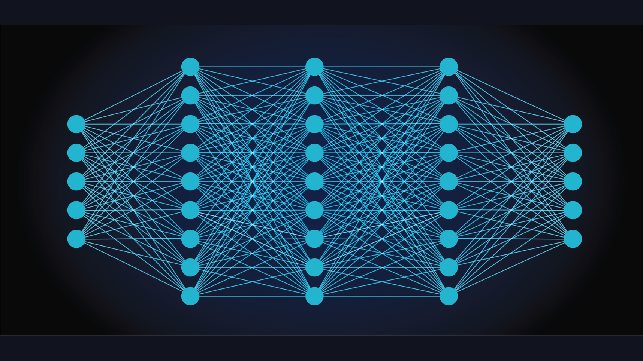
Klassen: Neural Network

Slide 135
Klassen: Neural Network
Ziel: AI in Java. Dafür brauchen wir Neuronale Netwerke (NNs)
Wir schreiben also eine Klasse NeuralNetwork, welche ein neuronales Netzwerk modelliert.
Neuron

Slide 136
Klassen: Neural Network
Ziel: AI in Java. Dafür brauchen wir Neuronale Netwerke (NNs)
Wir schreiben also eine Klasse NeuralNetwork, welche ein neuronales Netzwerk modelliert.
Ein “Layer” von einem NN.

Slide 137
Klassen: Neural Network
Ziel: AI in Java. Dafür brauchen wir Neuronale Netwerke (NNs)
Wir schreiben also eine Klasse NeuralNetwork, welche ein neuronales Netzwerk modelliert.
l2
l1
Kante
Zwei Layers l1 und l2 welche durch Kanten verbunden sind, welche jeweils ein Gewicht besitzen.

Slide 138
Klassen: Neural Network
Ziel: AI in Java. Dafür brauchen wir Neuronale Netwerke (NNs)
Wir schreiben also eine Klasse NeuralNetwork, welche ein neuronales Netzwerk modelliert.
Das NN

Slide 139
Klassen: Neural Network
Das Neural Netzwerk ist aber nicht nur eine Ansammlung an Layers, Weights und Neuronen (was einen Typ definiert). Es besitzt zusätzlich ein Verhalten, welches durch Methoden der Klasse definiert wird.
Das NN

Slide 140
public class Neuron {
private int value;
public Neuron(int value) {
this.value = value;
}
public Neuron() {
this(0);
}
public int getValue() {
return value;
}
public void setValue(int value) {
this.value = value;
}
}

Slide 141
public class Neuron {
private int value;
public Neuron(int value) {
this.value = value;
}
public Neuron() {
this(0);
}
public int getValue() {
return value;
}
public void setValue(int value) {
this.value = value;
}
}
Klasse (gespeichert in Neuron.java) – public access modifier
Attribut – private access modifier
Wir wollen, dass jeder die Klasse nutzen kann, aber der Zugriff auf die Attribute nur durch Methoden der Klasse erlaubt ist.
141

Slide 142
public class Neuron {
private int value;
public Neuron(int value) {
this.value = value;
}
public Neuron() {
this(0);
}
public int getValue() {
return value;
}
public void setValue(int value) {
this.value = value;
}
}
Konstruktoren
Getter und Setter Methoden
142

Slide 143
public class Layer {
private Neuron[] neurons;
private double[] weights;
public Layer(Neuron[] neurons, double[] weights) {
this.neurons = neurons;
this.weights = weights;
}
public Layer() {
this(null, null);
}
public double[] getWeights() {
return weights;
}
public void setWeights(double[] weights) {
this.weights = weights;
}
public void changeWeight(int index, double value) {
this.weights[index] = value;
}
}
public class Neuron {
private int value;
public Neuron(int value) {
this.value = value;
}
public Neuron() {
this(0);
}
public int getValue() {
return value;
}
public void setValue(int value) {
this.value = value;
}
}
Ein Benutzer kann nach dem Erstellen eines Layers nur noch die Weights ändern, nicht mehr aber die interne Struktur des Layers.
Klassenmethode – auch Member-Methode

Slide 144
public class NeuralNetwork {
private Layer[] layers;
public NeuralNetwork(Layer[] layers) {
this.layers = layers;
}
public NeuralNetwork() {
this(null);
}
public Layer getOutputs() {
return this.layers[layers.length - 1];
}
public void train() {
// TODO
}
}
public class Layer {
private Neuron[] neurons;
private double[] weights;
public Layer(Neuron[] neurons, double[] weights) {
this.neurons = neurons;
this.weights = weights;
}
public Layer() {
this(null, null);
}
public double[] getWeights() {
return weights;
}
public void setWeights(double[] weights) {
this.weights = weights;
}
public void changeWeight(int index, double value) {
this.weights[index] = value;
}
}
public class Neuron {
private int value;
public Neuron(int value) {
this.value = value;
}
public Neuron() {
this(0);
}
public int getValue() {
return value;
}
public void setValue(int value) {
this.value = value;
}
}
Layer.java
Neuron.java
Hier geben wir dem User nur Zugriff auf den Output des NNs der Rest geschieht intern.

Slide 145
public class NeuralNetwork {
private Layer[] layers;
public NeuralNetwork(Layer[] layers) {
this.layers = layers;
}
public NeuralNetwork() {
this(null);
}
public Layer getOutputs() {
return this.layers[layers.length - 1];
}
public void train() {
// TODO
}
}
public class Layer {
private Neuron[] neurons;
private double[] weights;
public Layer(Neuron[] neurons, double[] weights) {
this.neurons = neurons;
this.weights = weights;
}
public Layer() {
this(null, null);
}
public double[] getWeights() {
return weights;
}
public void setWeights(double[] weights) {
this.weights = weights;
}
public void changeWeight(int index, double value) {
this.weights[index] = value;
}
}
public class Neuron {
private int value;
public Neuron(int value) {
this.value = value;
}
public Neuron() {
this(0);
}
public int getValue() {
return value;
}
public void setValue(int value) {
this.value = value;
}
}
NeuralNetwork.java
Layer.java
Neuron.java

Slide 146
Klassen: Neural Network
Problem: Was wenn wir nicht jedes Neuron in einem Layer mit allen Neuronen im nächsten Layer mit Kanten verbinden wollen?
Kante
Neuron

Slide 147
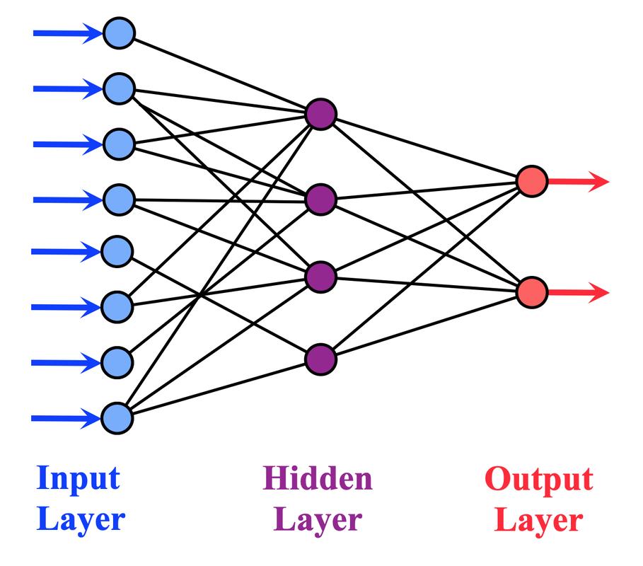
Klassen: Neural Network
Problem: Was wenn wir nicht jedes Neuron in einem Layer mit allen Neuronen im nächsten Layer mit Kanten verbinden wollen?
1
Ein boolean array pro Neuron würde reichen.
2
1 | 0 | 0 | 0
3
1
2
3
4
4

Slide 148
Klassen: Neural Network
Problem: Was wenn wir nicht jedes Neuron in einem Layer mit allen Neuronen im nächsten Layer mit Kanten verbinden wollen?
1
Ein boolean array pro Neuron würde reichen.
2
✨ Vererbung! ✨
1 | 0 | 0 | 0
3
1
2
3
4
4

Slide 149
public class SparseNetwork extends NeuralNetwork {
private boolean[][] connections;
public SparseNetwork(Layer[] layers, boolean[][] connections) {
super(layers);
this.connections = connections;
}
public SparseNetwork() {
SparseNetwork(null, null);
}
@Override
public void train() {
// TODO
}
}
public class NeuralNetwork {
private Layer[] layers;
public NeuralNetwork(Layer[] layers) {
this.layers = layers;
}
public NeuralNetwork() {
this(null);
}
public Layer getOutputs() {
return this.layers[layers.length - 1];
}
public void train() {
// TODO
}
}
public class Neuron {
private int value;
public Neuron(int value) {
this.value = value;
}
public Neuron() {
this(0);
}
public int getValue() {
return value;
}
public void setValue(int value) {
this.value = value;
}
}
Neuron.java
public class Layer {
private Neuron[] neurons;
private double[] weights;
public Layer(Neuron[] neurons, double[] weights) {
this.neurons = neurons;
this.weights = weights;
}
public Layer() {
this(null, null);
}
public double[] getWeights() {
return weights;
}
public void setWeights(double[] weights) {
this.weights = weights;
}
public void changeWeight(int index, double value) {
this.weights[index] = value;
}
}
SparseNetwork.java
NeuralNetwork.java
Layer.java

Slide 150
private static class SparseNetwork extends NeuralNetwork {
private boolean[][] connections;
public SparseNetwork(Layer[] layers, boolean[][] connections) {
super(layers);
this.connections = connections;
}
public SparseNetwork() {
SparseNetwork(null, null);
}
@Override
public void train() {
// TODO
}
}
Connections Array pro Layer. In jedem Layer ein Array pro Neuron.

Slide 151
private static class SparseNetwork extends NeuralNetwork {
private boolean[][] connections;
public SparseNetwork(Layer[] layers, boolean[][] connections) {
super(layers);
this.connections = connections;
}
public SparseNetwork() {
SparseNetwork(null, null);
}
@Override
public void train() {
// TODO
}
}
Die restlichen Attribute werden von NeuralNetwork geerbt.

Slide 152
private static class SparseNetwork extends NeuralNetwork {
private boolean[][] connections;
public SparseNetwork(Layer[] layers, boolean[][] connections) {
super(layers);
this.connections = connections;
}
public SparseNetwork() {
SparseNetwork(null, null);
}
@Override
public void train() {
// TODO
}
}
Konstruktoren werden nie geerbt!

Slide 153
private static class SparseNetwork extends NeuralNetwork {
private boolean[][] connections;
public SparseNetwork(Layer[] layers, boolean[][] connections) {
super(layers);
this.connections = connections;
}
public SparseNetwork() {
SparseNetwork(null, null);
}
@Override
public void train() {
// TODO
}
}
Wir rufen den Konstruktor der Superklasse und initialisieren das Connections-Array zusätzlich.

Slide 154
private static class SparseNetwork extends NeuralNetwork {
private boolean[][] connections;
public SparseNetwork(Layer[] layers, boolean[][] connections) {
super(layers);
this.connections = connections;
}
public SparseNetwork() {
SparseNetwork(null, null);
}
@Override
public void train() {
// TODO
}
}
Die train-Methode aus der Superklasse kennt kein connection Array. Wir überschreiben diese Methode also.

Slide 155
private static class SparseNetwork extends NeuralNetwork {
private boolean[][] connections;
public SparseNetwork(Layer[] layers, boolean[][] connections) {
super(layers);
this.connections = connections;
}
public SparseNetwork() {
SparseNetwork(null, null);
}
@Override
public void train() {
// TODO
}
}
@Override stellt sicher, dass dies wirklich eine Überschreibung ist. Ansonsten gibt es einen Fehler bei der Ausführung.

Slide 156
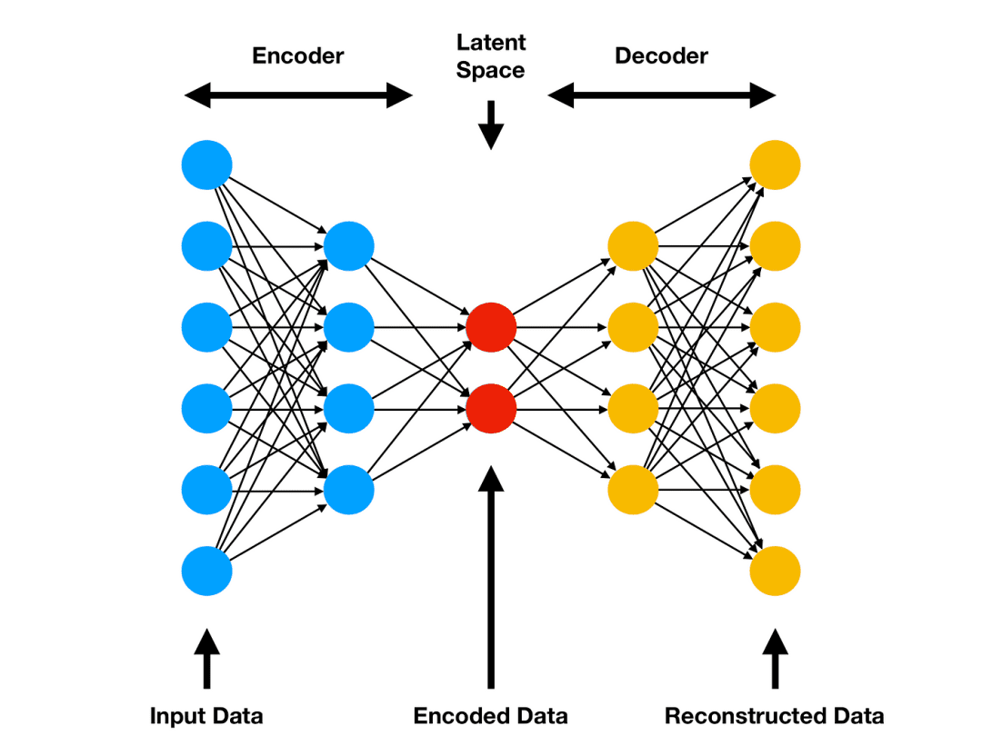
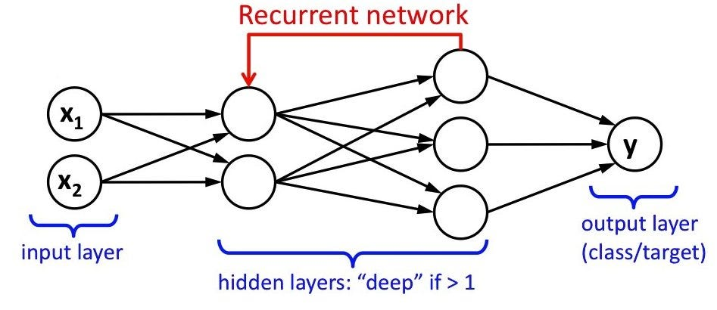
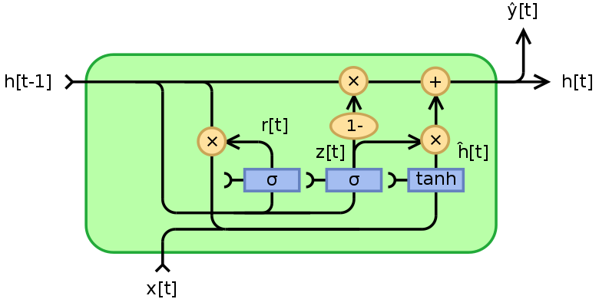
Klassen: Neural Network
Wir könnten diverse neuronale Netzwerke so durch eine Klasse beschreiben…
Object

Slide 157
Object
Alle Klassen sind Subklassen von der Klasse Object.

Slide 158
Object
SparseNetwork ist auch ein NeuralNetwork.

Slide 159
NeuralNetwork ist kein SparseNetwork.
Object

Slide 160
Diese zwei Klassen erben beide von NeuralNetwork, aber sie sind nicht direkt verwandt.
Object

Slide 161
Vorbesprechung

Slide 162
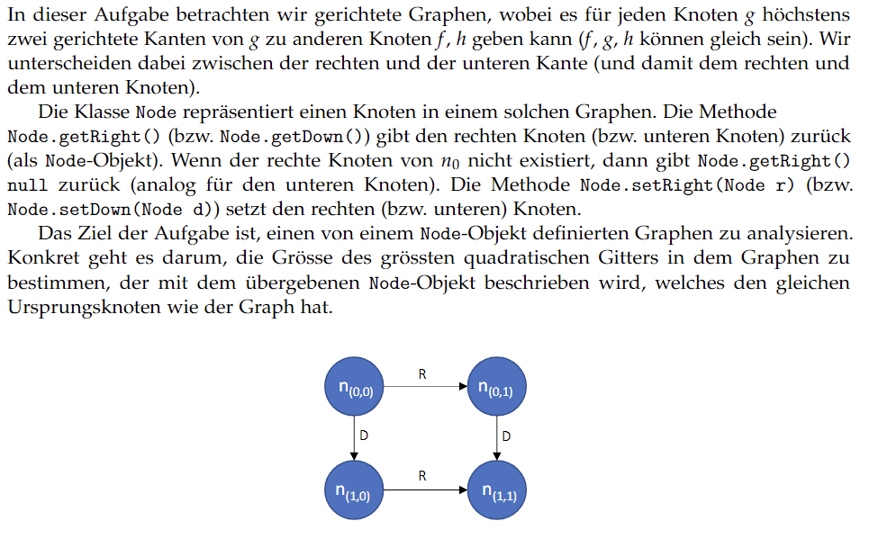
Aufgabe 1: Square Grid

Slide 163
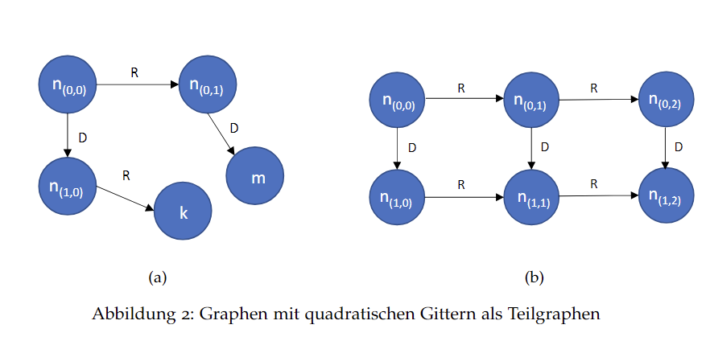
Aufgabe 1: Square Grid
Referenzen vs Objekte

Slide 164
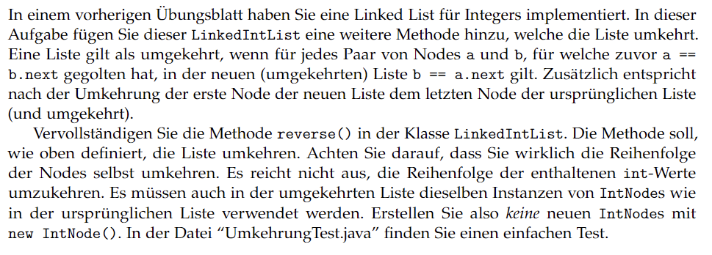
Aufgabe 2: Umkehrung

Slide 165
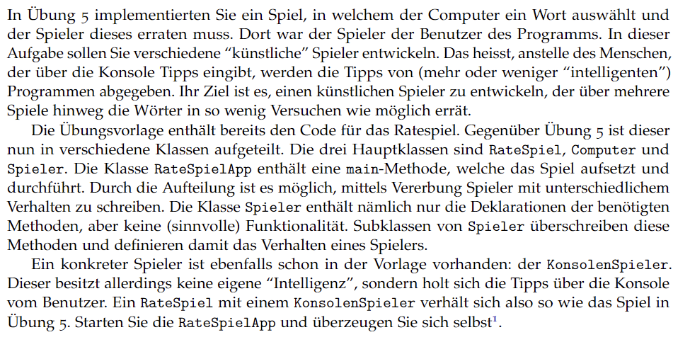
Aufgabe 3: “KI” für das Ratespiel

Slide 166
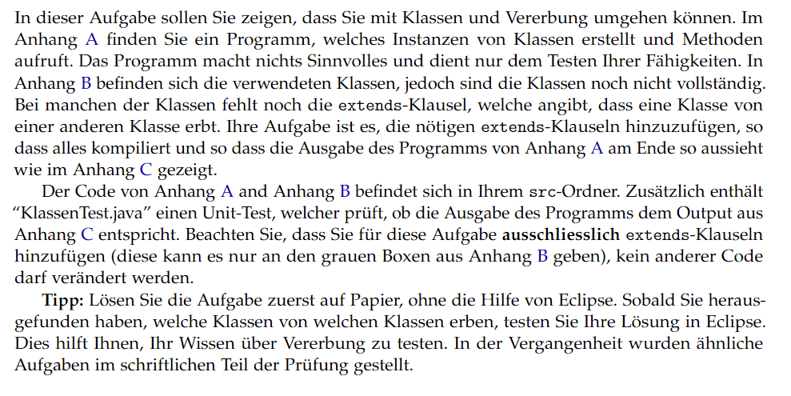
Aufgabe 4: Klassenrätsel

Slide 167
Nachbesprechung

Slide 168
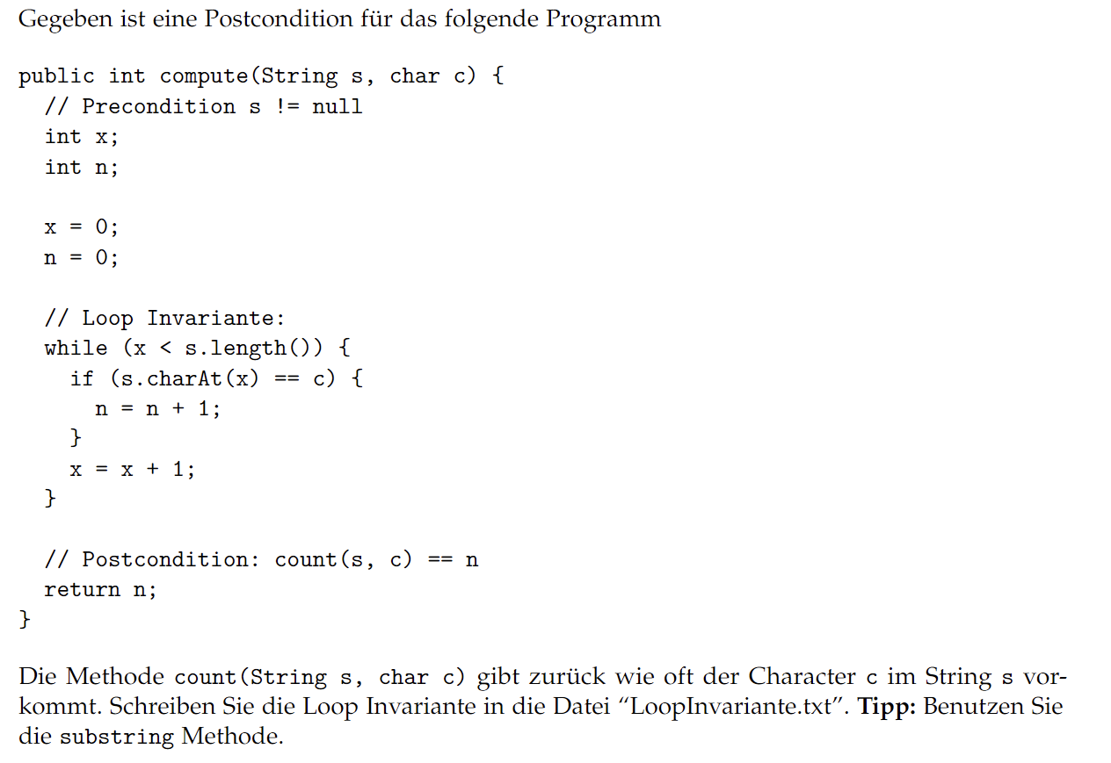
Aufgabe 1: Loop-Invariante

Slide 169
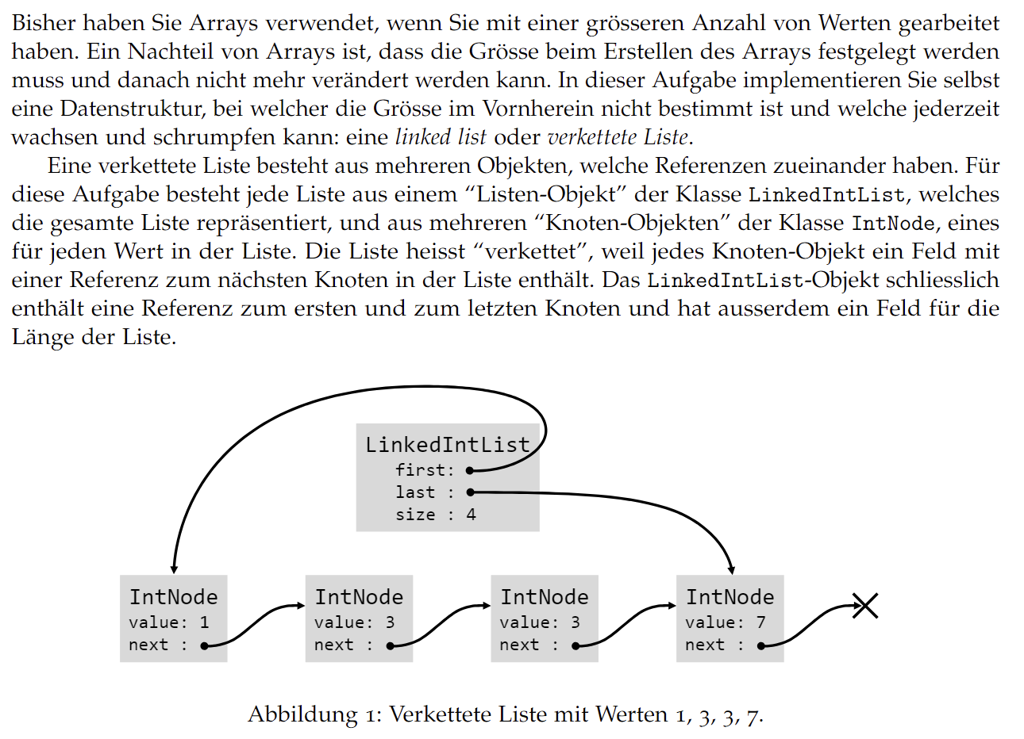
Aufgabe 2: Linked List

Slide 170
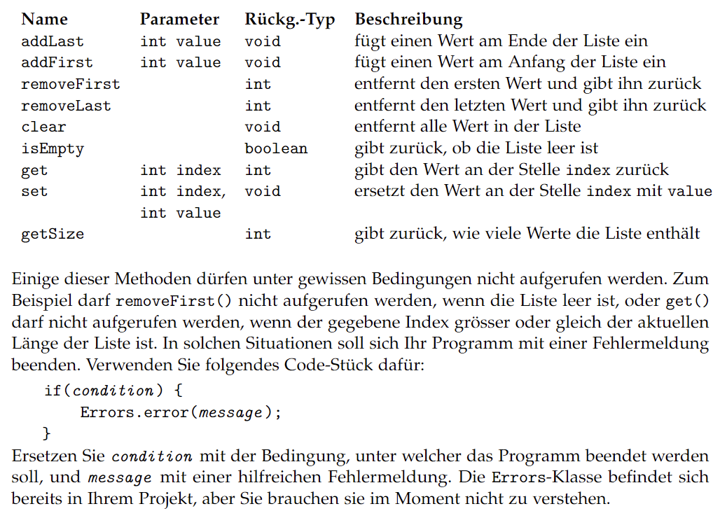
Aufgabe 2: Linked List

Slide 171
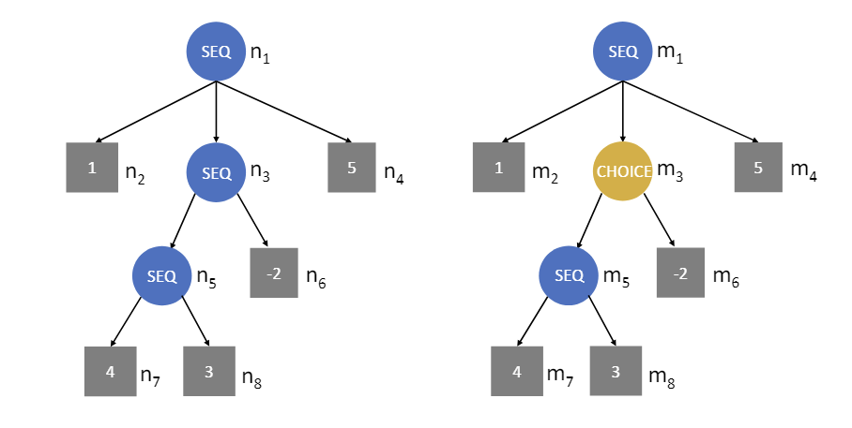
Aufgabe 3: Executable Graph

Slide 172
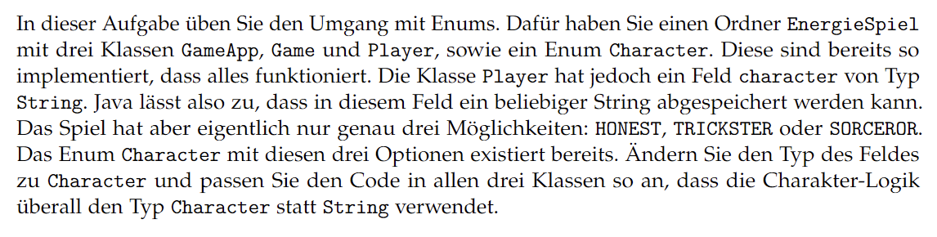
Aufgabe 4: Energiespiel

Slide 173
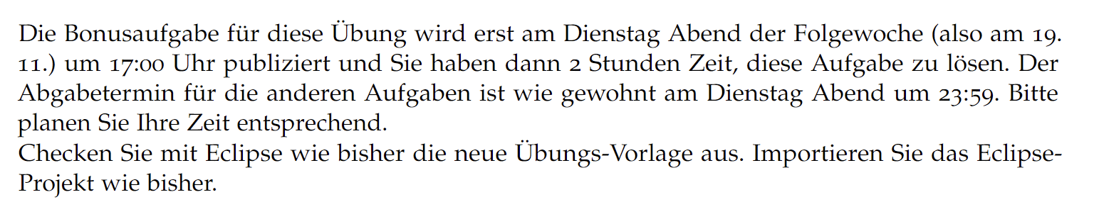
Aufgabe 5: Timed Bonus

